Slide 1
Capstone Engagement
Assessment, Analysis, and Hardening of a Vulnerable System

Slide 2
Table of Contents
This document contains the following sections:
01
Network Topology
02
Red Team: Security Assessment
03
Blue Team: Log Analysis and Attack Characterization
Hardening: Proposed Alarms and Mitigation Strategies
04

Slide 3
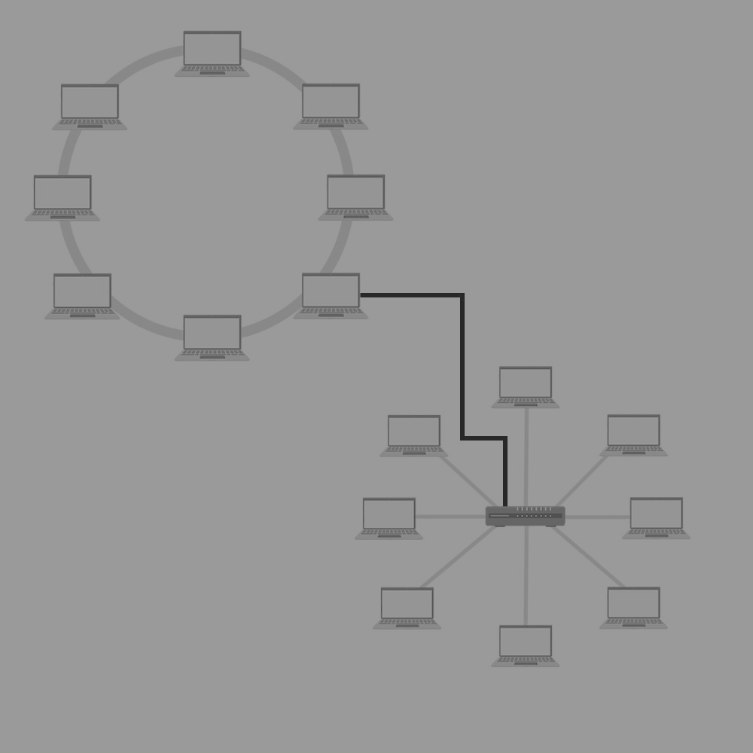
Network Topology
‹#›

Slide 4
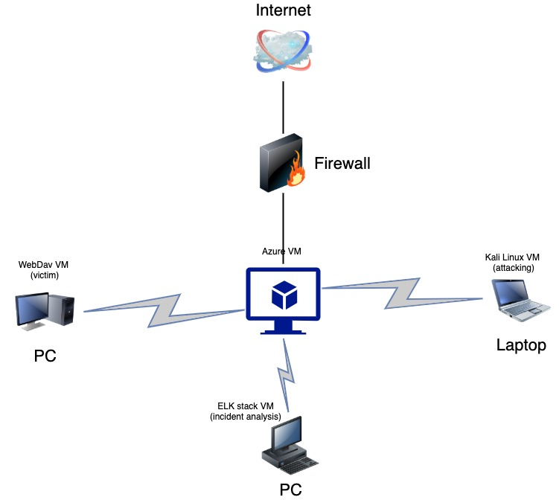
Network Topology
Network
Address Range: 192.178.1.100/28
Machines
IPv4: 192.168.1.190
OS: Linux
Hostname: Attacker
IPv4: 192.168.1.105
OS: Windows
Hostname: Victim
IPv4: 192.168.1.100
OS: Windows
Hostname: ELK stack

Slide 5

Red Team
Security Assessment
‹#›

Slide 6
Recon: Describing the Target
Nmap identified the following hosts on the network:
Hostname | IP Address | Role on Network
Victim | 192.168.1.105 | Web server

Slide 7
Vulnerability Assessment
The assessment uncovered the following critical vulnerabilities in the target:
Vulnerability | Description | Impact
Port 80 is open | This will allow us to be able to look for HTTP exploits | We can gain limited access to the web server and place a reverse shell on the machine
Running apache httpd 2.4.29 | There are several vulnerabilities for this version of apache | Using some of the posted exploits we can escalate privileges and gain root access
Port 22 is open | This will allow SSH access to the machine | If we are able to gain access to user names and passwords we can instantly have root access

Slide 8
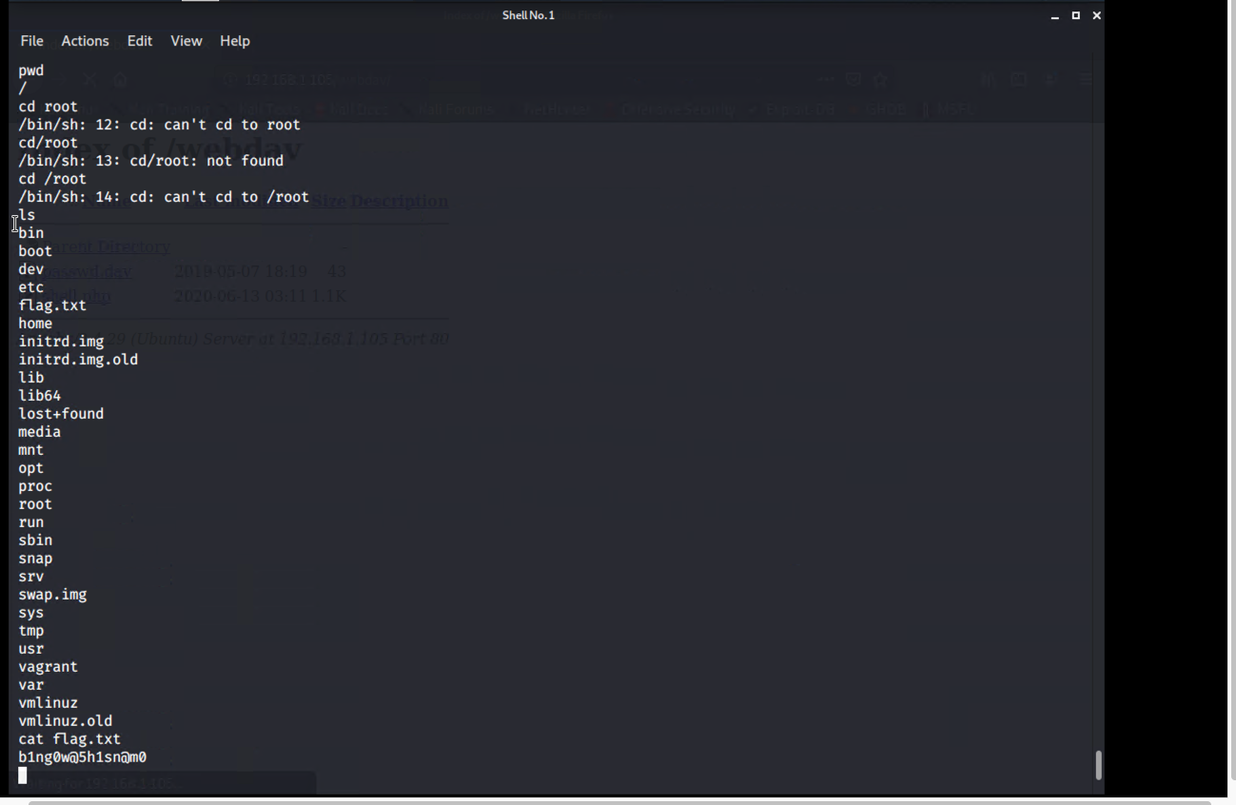
Exploitation: [NMAP Scanning and brute force attack]
01
02
03
Tools & Processes
I used NMAP to scan the IP and found port 80 open to HTTP traffic. I then navigated to the web directory and found a hidden directory. I used Hydra with the RockYou wordlist to brute force a password for limited access. That led me to a higher access user with hashed password. I used those credentials to upload a PHP shell to gain full access
Achievements
Nmap told me where to look.
Hydra gave me limited login credentials.
Cracking the password hash gave me a password with higher access.
The reverse PHP shell allowed me root access to the file system.
[INSERT: screenshot or command output illustrating the exploit.]

Slide 9
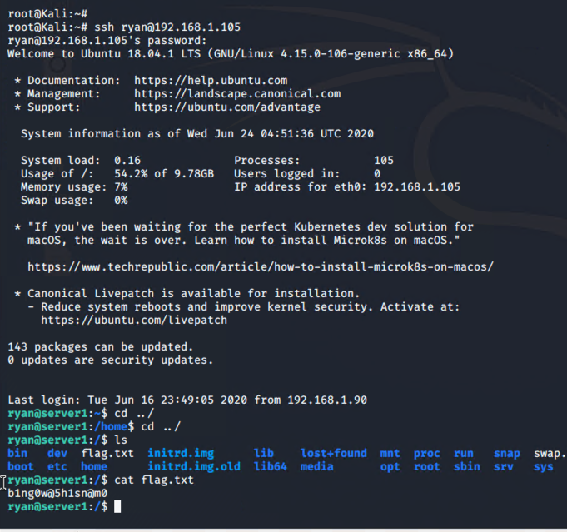
Exploitation: [Name of Second Vulnerability]
01
02
03
Tools & Processes
SSH into the machine
Achievements
I was able to gain full access through SSH on port 22 using the higher level credentials I was able to gain.
[INSERT: screenshot or command output illustrating the exploit.]

Slide 10

Blue Team
Log Analysis and Attack Characterization
‹#›

Slide 11
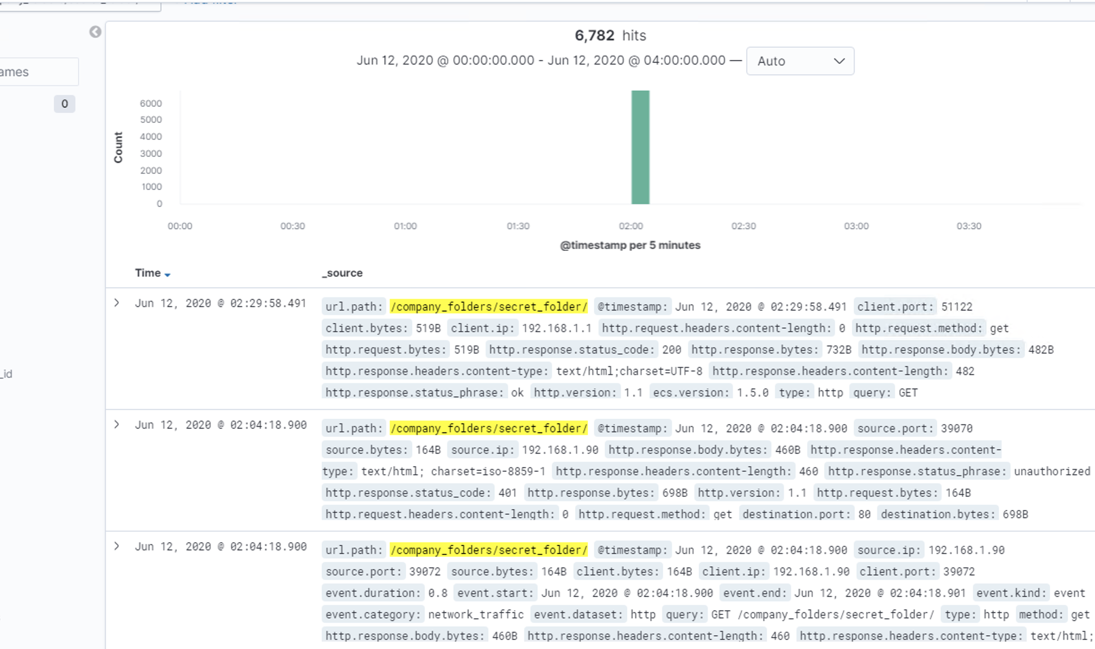

Analysis: Finding the Request for the Hidden Directory
Answer the following questions in bullet points under the screenshot if space allows. Otherwise, add the answers to speaker notes.
The requests occur over a 5 min period in rapid succession
There are multiple Get requests to the secret folder directory

Slide 12
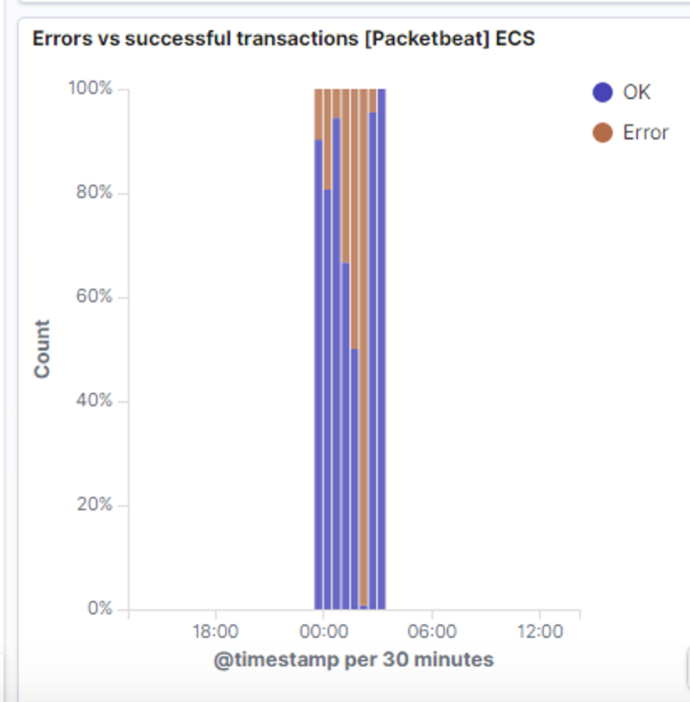
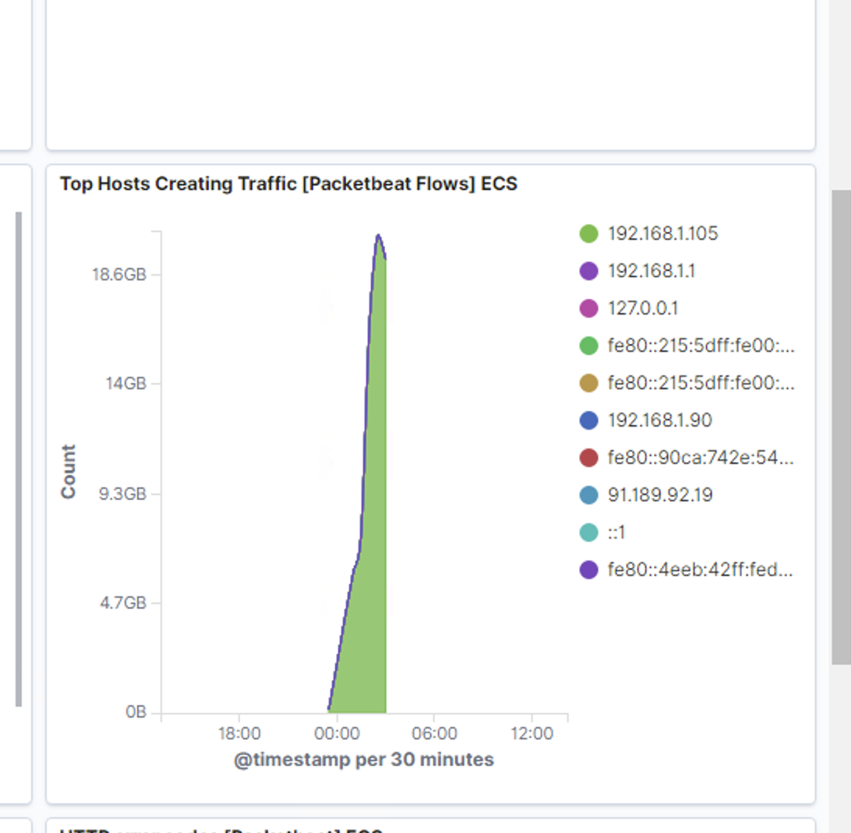
Analysis: Uncovering the Brute Force Attack
Here we see a large spike in errors to along with a high amount of traffic going to the victim IP
We can see that there were a lot unsuccessful transactions and that traffic became more successful immediately afterward

Slide 13
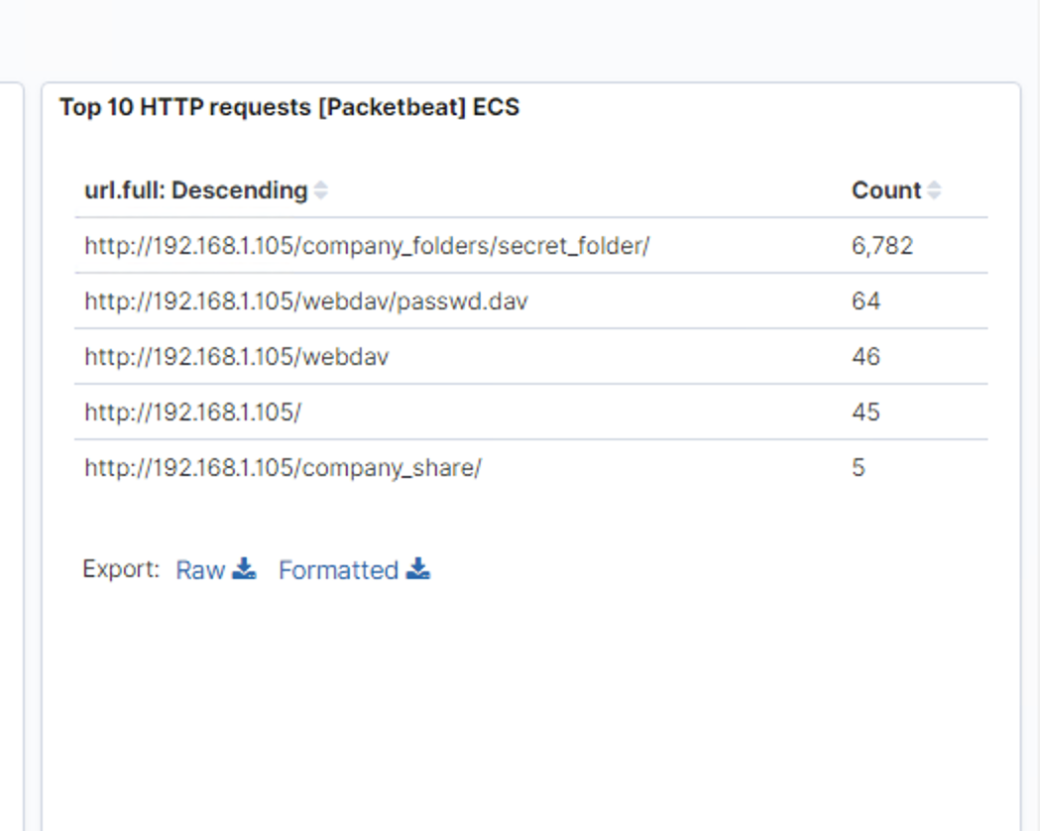
Analysis: Finding the WebDAV Connection
Answer the following questions in bullet points under the screenshot if space allows. Otherwise, add the answers to speaker notes.
We see that after the secret folder brute force attack there is a spike in requests for webdav and passwd.dav directories

Slide 14
Blue Team
Proposed Alarms and Mitigation Strategies
‹#›

Slide 15
Mitigation: Finding the Request for the Hidden Directory
What kind of alarm can be set to detect future unauthorized access?
There could be an alert that would trigger when a request for the hidden directory is made by an unauthorized IP address or if unique flows are higher than a set threshold.
The threshold would be rather high but would be if there are a high amount of traffic over a short time duration
The secret_folder directory should be removed all together.

Slide 16
Mitigation: Preventing Brute Force Attacks
Here we can set another threshold on requests to the hidden folder, specifically unauthorized status codes.
The easiest method of hardening is to set a limit for password attempts with an account lockout policy. This would block the user from trying to brute force the password.
This can be configured in Apache
Impacted Attributes: ads-pwdLockout, ads-pwdMaxFailure, ads-pwdLockoutDuration

Slide 17
Mitigation: Detecting the WebDAV Connection
We can create an alert whenever this directory is accessed outside of our network.
Any access outside our network would trigger this alert.
Connections to this directory should not be accessed through a web interface. This can be configured in the firewall to block any unauthorized access

Slide 18
Mitigation: Identifying Reverse Shell Uploads
During the attack we uploaded a php shell to the webdav directory. We can set an alert for any .php file.
Port 4444 was used as a listening port for the meterpreter shell. We can also set an alert for any traffic with a destination port of 4444
We can block the ability to upload files to this directory over web interface.
We can also block port 4444 in the firewall settings so any IP with dest port 4444 is blocked.

